Slide 1
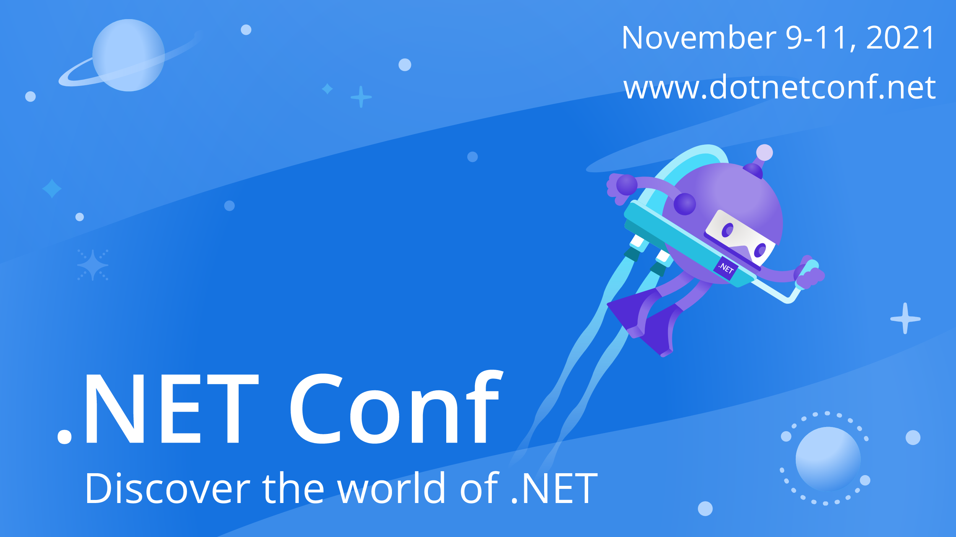

Slide 2

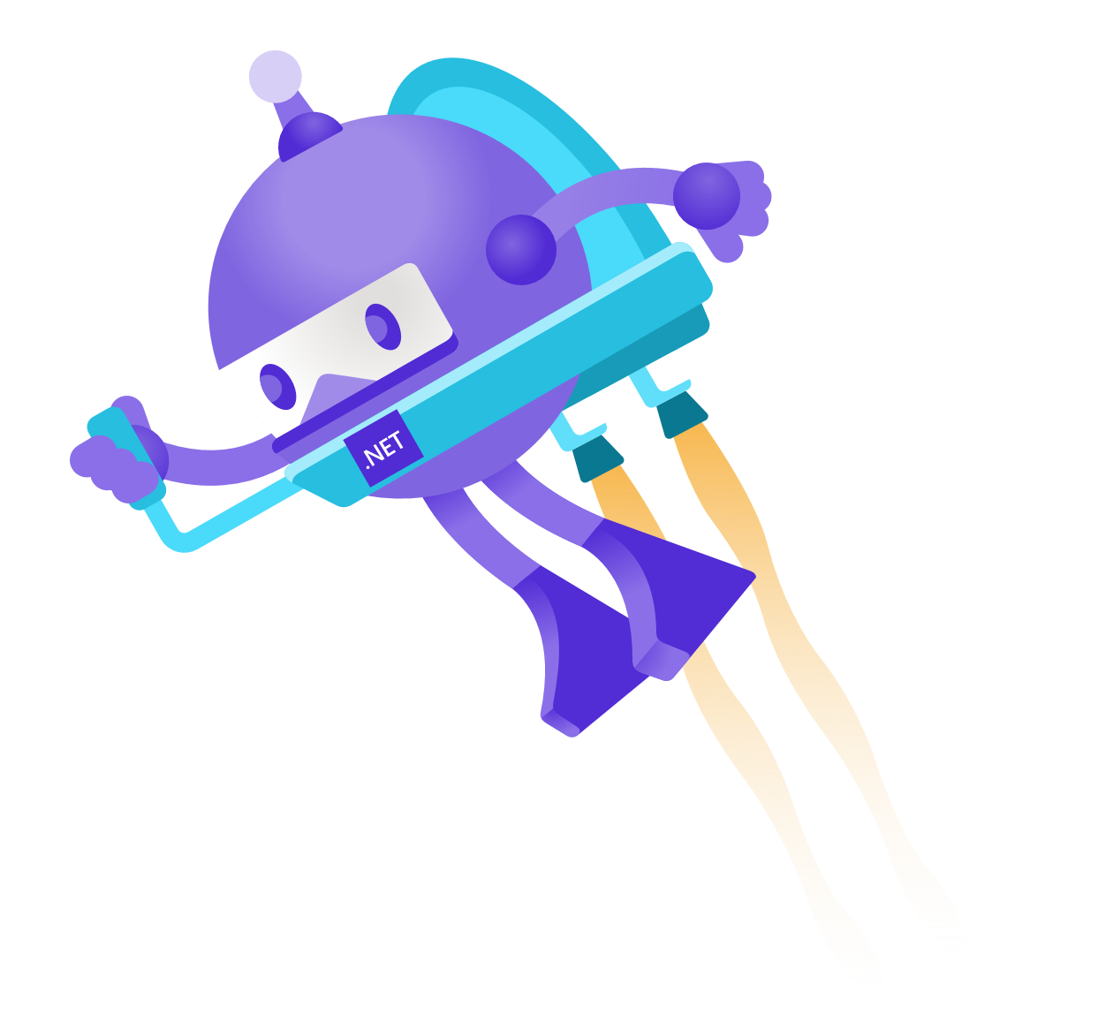
Building A Production Ready Blazor WASM App
Steven Peirce (@srpeirce)

Slide 3
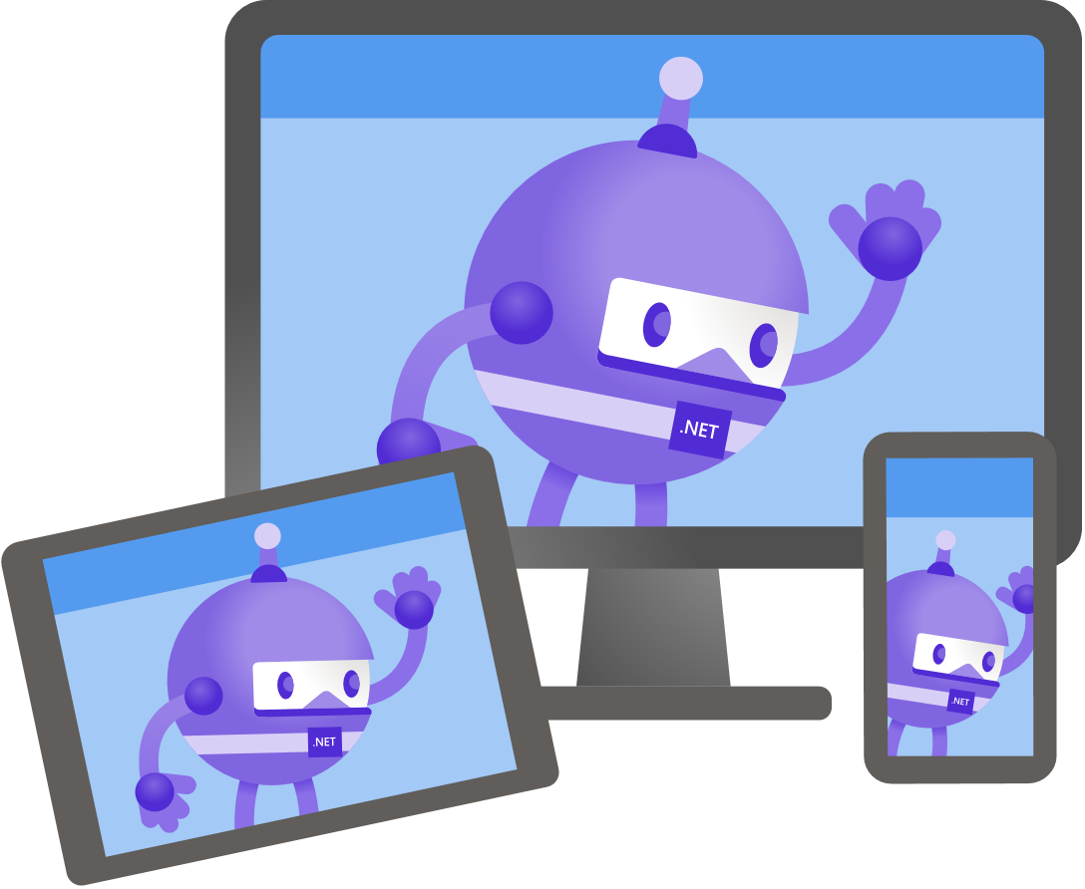
What does “Production Ready” mean?
We offer a great experience to users
Our code is maintainable
Notes:
Well today I’m going to focus in 2 areas…
Great experience for users and maintainable code, meaning we can iterate quickly and confidently without introducing regressions

Slide 4

How to offer a great experience to users
PreRender the app
No more loading screen
Great for SEO
Reduce download size
Let’s only download what we need
Notes:
How can we offer a great experience to users?
Today we’ll look at removing some annoying loading screens whilst the wasm app loads,
Make the customers happy and great for SEO
And let’s see if we can optimise the download size for a slimmer app, saving precious bandwidth which is perfect for anybody on a poor or metred connection.

Slide 5

How to write maintainable code
Test our components with Bunit
Confidence to add new features
Confidence to refactor
Notes:
We’ll take a quick look at how we can write maintainable and non-brittle code, using Bunit to give us confidence!
This will Segway nicely into the next section ☺

Slide 6
Demo
Steven Peirce (@srpeirce)
Notes:
Enough talking….let’s take a look at some code…

Slide 7
Download Source Code
https://github.com/srpeirce/dotnet-conf-2021-blazor-beast

Slide 8

Thanks for joining!

